Slide 1














ISO Lead Implementer Advanced Training
Mastering the Audit Process, Driving Continual Improvement, Strategic Management Review, Maintaining Certification
Audit Process
Continual Improvement
Management Review
Certification
December 01, 2025
ISO Lead Implementer Advanced Training

Slide 2











Training Agenda Overview
Four critical areas of focus for advanced ISO Lead Implementer responsibilities
Mastering the Audit Process
Driving Continual Improvement
Developing risk-based audit schedules, selecting competent auditors, and managing both internal and external audits to ensure compliance and continuous improvement.
Implementing the improvement cycle, conducting root cause analysis, and developing effective corrective actions to enhance the ISMS and AIMS.
The Strategic Management Review
Maintaining Certification
Managing the surveillance audit cycle, keeping management systems current with changing requirements, and maturing the ISMS and AIMS beyond certification.
Preparing for effective management reviews, presenting to senior leadership, and using strategic dialogue to drive improvement and resource allocation.
ISO Lead Implementer Advanced Training | 2/23

Slide 3














Evolution of the Lead Implementer Role
From audit subject to strategic management function
Traditional Role
Modern Role
Subject to audits
Strategic management function
Compliance-focused
Proactive oversight
Reactive approach
Comprehensive audit program management
Key Strategic Responsibilities
Risk-Based Planning
Auditor Development
Continuous Improvement
Strategic scheduling of audits based on risk assessment
Selecting and training competent internal auditors
Ensuring compliance and driving ongoing enhancement
ISO Lead Implementer Advanced Training | 3/23

Slide 4












Internal Audit Program Development
Creating risk-based audit schedules for ISMS and AIMS components
Key Development Elements
Risk-Based Audit Approach
Risk Assessment: Identify and evaluate risks to determine audit priority
A risk-based audit schedule prioritizes areas based on their risk to the organization.
Scope Definition: Ensure comprehensive coverage of all ISMS/AIMS components
High Risk
Components with highest potential impact
Resource Allocation: Assign appropriate audit resources based on risk levels
Medium Risk
Frequency Planning: Establish audit schedules that ensure timely reviews
Components with moderate potential impact
Low Risk
Components with lower potential impact
ISO Lead Implementer Advanced Training | 4/23

Slide 5




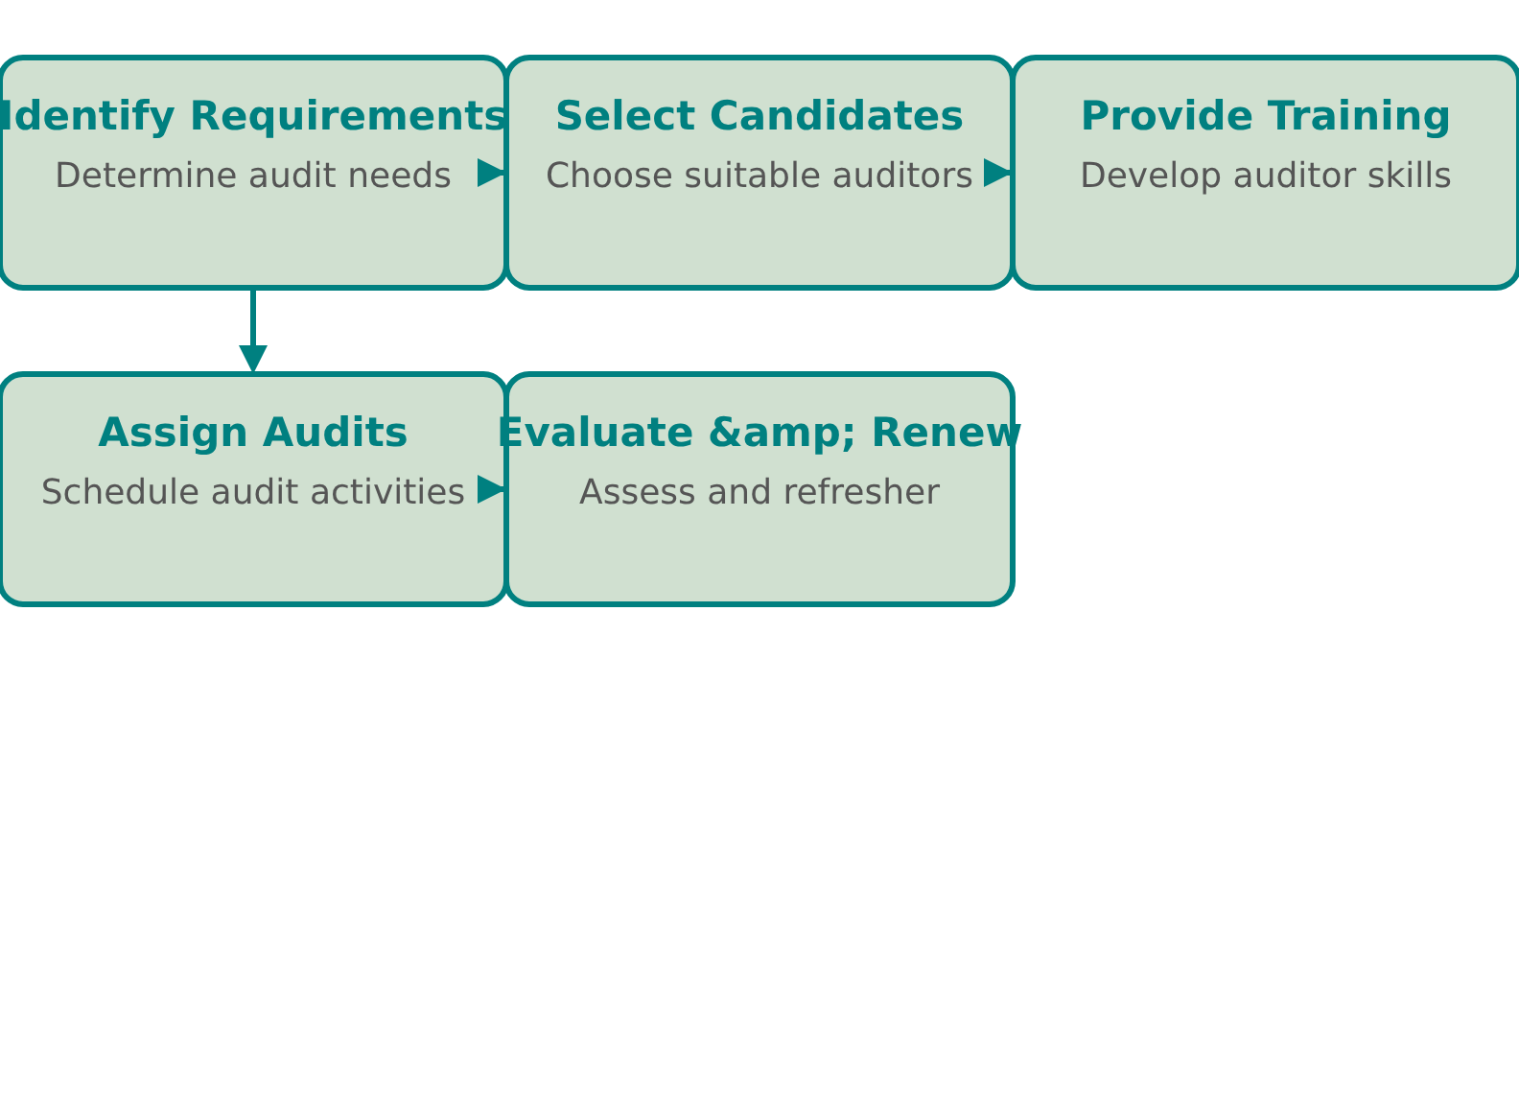



Auditor Selection and Training
Ensuring internal auditors possess necessary competence, independence, and resources
Key Selection Criteria
Selection & Training Process
Competence: Technical knowledge and skills relevant to the audit scope
Independence: Objectivity and freedom from conflicts of interest
Resources: Adequate time and support to conduct thorough audits
Training Requirements
Initial certification in ISO auditing principles
Regular refresher training to maintain skills
Technical updates on changing standards
ISO Lead Implementer Advanced Training | 5/23

Slide 6








Audit Process Oversight
The Lead Implementer's role in ensuring audit effectiveness and follow-through
As the manager of the audit program, the Lead Implementer must ensure audits are conducted effectively and that necessary actions are taken to address findings.
Monitoring Progress
Reviewing Findings
Corrective Action
Track audit schedule compliance
Meticulously examine audit evidence
Ensure prompt implementation
Identify and resolve audit delays
Verify conformity with standards
Verify effectiveness of actions
Effective oversight ensures audits drive continuous improvement and compliance.
ISO Lead Implementer Advanced Training | 6/23

Slide 7








External Audit Preparation Strategy
Key steps for certification success
Organizing Documentation
Ensure all documentation is organized and up-to-date. Conduct internal simulations to identify and address gaps before the external audit.
Preparing Employees
Educate employees on their responsibilities during an audit. Ensure they understand the importance of cooperation and transparency.
Facilitating Audit Conduct
Establish clear processes for providing information to auditors. Ensure the audit is conducted professionally and efficiently.
A well-prepared organization can reduce audit pressure and improve certification outcomes.
ISO Lead Implementer Advanced Training | 7/23

Slide 8











Managing External Auditors
Ensuring a professional audit process during certification audits
The Lead Implementer's Role
Providing Efficient Information Access
Ensure auditors have timely access to all required documentation while maintaining information security. Establish clear protocols for document retrieval and review.
As the manager of the audit program, the Lead Implementer must facilitate external certification audits efficiently while maintaining professional standards.
Managing Auditor Conduct
Facilitate professional audit conduct by setting expectations, providing clear communication channels, and ensuring auditors understand organizational processes.
External audits can be high-pressure situations, but meticulous preparation ensures a seamless experience.
Coordinating Audit Activities
Schedule audit sessions, allocate resources, and coordinate access to personnel and facilities to ensure audit efficiency and effectiveness.
ISO Lead Implementer Advanced Training | 8/23

Slide 9












Nonconformity Response Framework
Systematic approach to documenting, evaluating, and resolving nonconformities
A systematic approach to nonconformities is crucial for maintaining certification and driving improvement. It ensures timely resolution and prevents recurrence.
Document
Evaluate
Act
Verify
Identify and document nonconformities clearly
Assess severity and impact of nonconformities
Develop and implement corrective actions
Monitor effectiveness of implemented actions
Key Benefits:
Maintains certification
Drives continuous improvement
Prevents recurrence
ISO Lead Implementer Advanced Training | 9/23

Slide 10







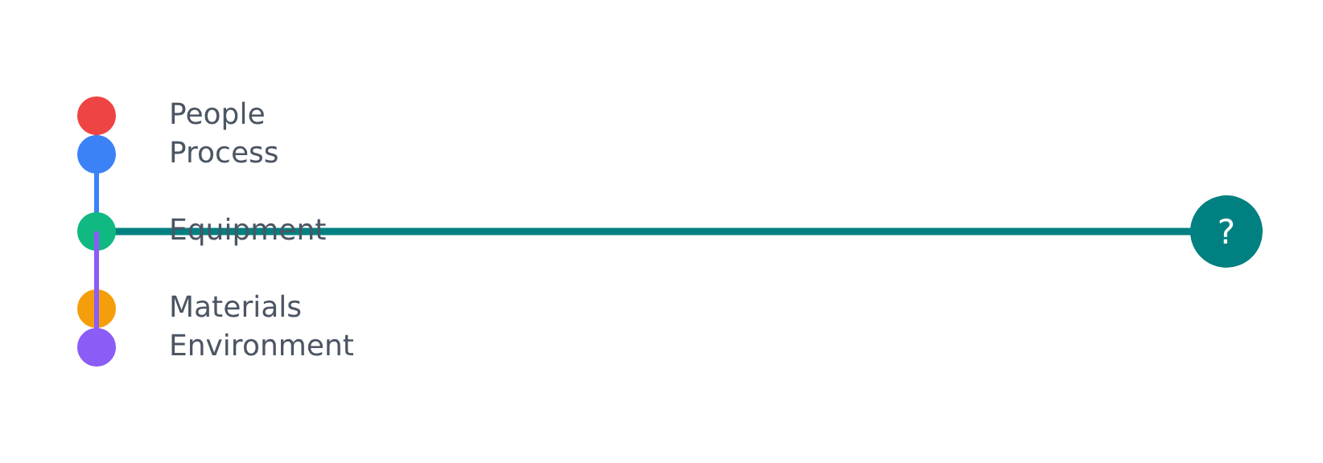

Root Cause Analysis Methodology
Understanding underlying causes to prevent recurrence
A systematic approach to managing nonconformities is crucial for effective continual improvement. Identifying the true root cause, rather than merely addressing symptoms, is paramount.
5 Whys Technique
Fishbone Diagram
A simple yet powerful questioning technique to explore cause-and-effect relationships.
A visual tool that groups causes into major categories to identify root causes.
Example:
Why did the system fail? → Security breach occurred
Why was the system vulnerable? → Outdated software
Why was outdated software used? → Budget constraints
Why were budget constraints an issue? → Poor planning
Why was planning inadequate? → Lack of risk assessment
People
Process
Equipment
Materials
Key takeaway: Effective root cause analysis prevents recurrence of issues and drives meaningful improvement.
ISO Lead Implementer Advanced Training | 10/23

Slide 11









Continual Improvement Principles
Fundamental principles driving the evolution of ISO 27001 and ISO 42001 management systems
Continual improvement stands as the fundamental principle at the heart of both ISO 27001 (Information Security Management Systems) and ISO 42001 (Artificial Intelligence Management Systems). As a Lead Implementer, your role is pivotal in orchestrating and driving this ongoing process within the organization.
Analyze Audit Results
Monitor Performance
Utilize findings from both internal and external audits to pinpoint areas requiring enhancement and identify systemic weaknesses.
Employ metrics and Key Performance Indicators (KPIs) to continuously track the effectiveness of the ISMS and AIMS, identifying trends and potential deviations.
Learn from Incidents
Root Cause Analysis
Conduct thorough post-incident reviews to ascertain the root causes of security breaches or AI-related incidents and implement corrective actions.
Identify the true root cause of problems rather than merely addressing symptoms. Use techniques like 5 Whys and Fishbone Diagrams to dig deeper.
ISO Lead Implementer Advanced Training | 11/23

Slide 12
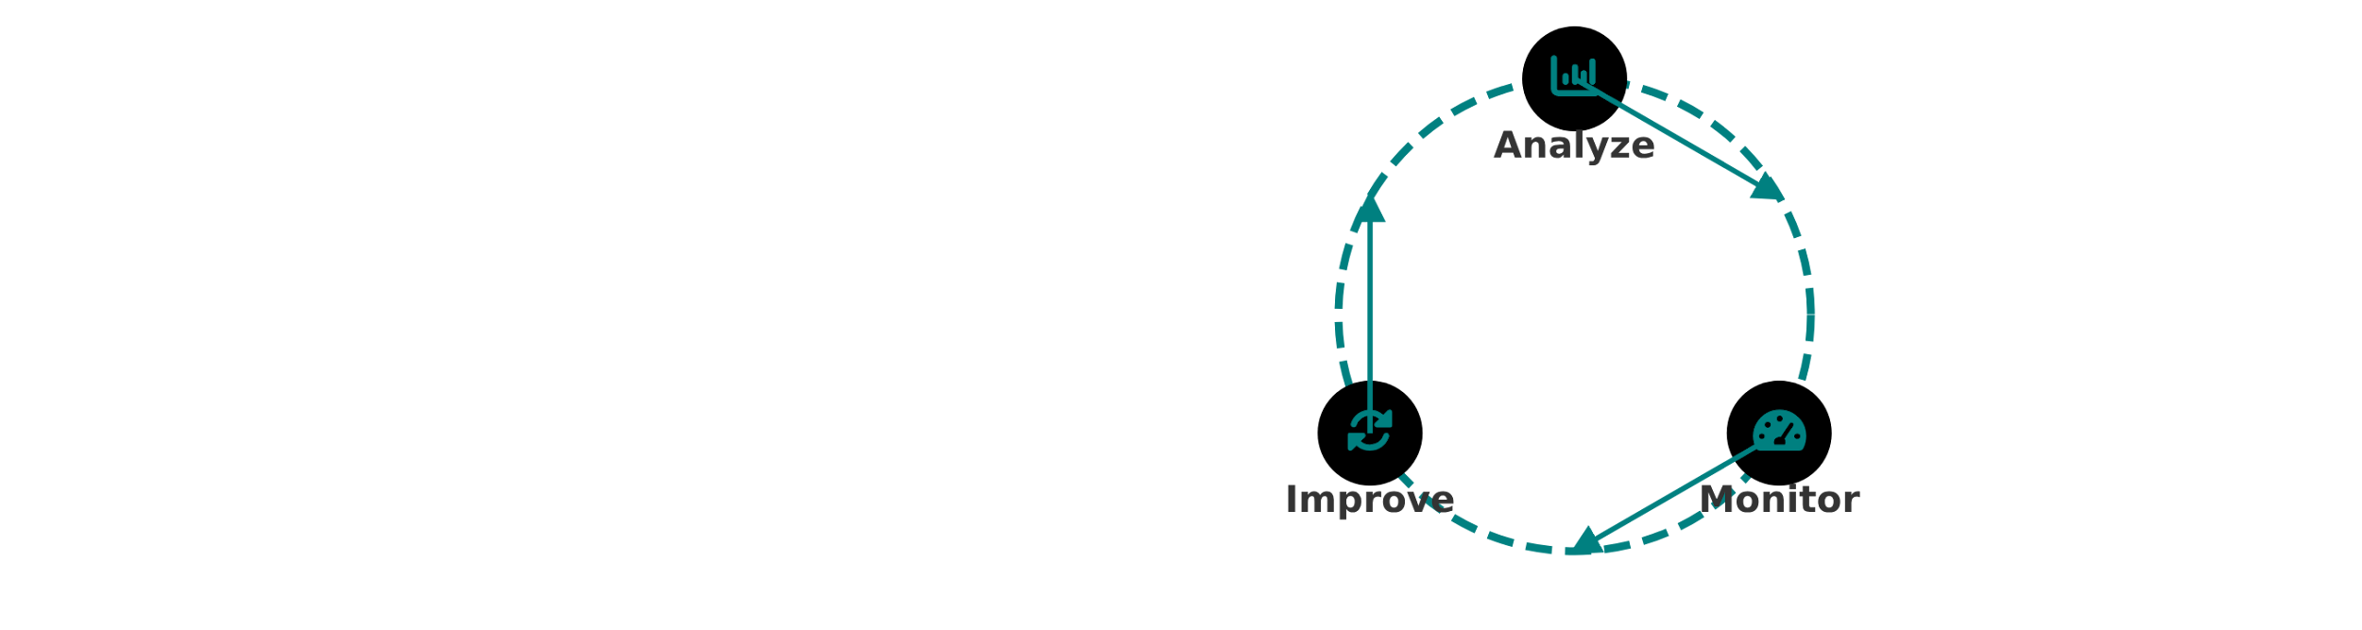







The Improvement Cycle Process
A dynamic process ensuring ISMS and AIMS evolve and strengthen over time
Analyze Audit Results
Monitor Performance
Learn from Incidents
Utilize findings from internal audits
Employ metrics and KPIs
Conduct post-incident reviews
Review external audit results
Track ISMS and AIMS effectiveness
Determine root causes of breaches
Identify systemic weaknesses
Identify trends and deviations
Implement corrective actions
Pinpoint areas requiring enhancement
Measure against objectives
Prevent recurrence of incidents
ISO Lead Implementer Advanced Training | 12/23

Slide 13






















Root Cause Analysis Techniques
Systematic approaches to identify true problem causes
5 Whys Technique
Fishbone Diagrams
A questioning technique to explore cause-and-effect relationships. Ask "Why?" repeatedly to dig deeper into the root cause.
A visual tool that categorizes potential causes to identify root causes. Groups causes into major categories.
Problem: Production delay
Problem
Why? Equipment breakdown
People
Process
Equipment
Materials
Environment
Management
Why? No maintenance schedule
Root Cause: Lack of maintenance protocol
ISO Lead Implementer Advanced Training | 13/23

Slide 14






Effective Corrective Action Development
Designing solutions that address root causes while tracking implementation progress and verifying effectiveness
Develop
Track
Verify
Developing Effective Solutions
Tracking Implementation
Verifying Effectiveness
Establish robust tracking systems
Monitor implemented actions
Design actions to directly address root causes
Monitor implementation progress
Verify solutions eliminate nonconformities
Document all activities
Ensure solutions prevent recurrence
Prevent recurrence of issues
Create clear, actionable statements
"Effective corrective actions are not just about fixing symptoms but addressing the root causes that lead to nonconformities."
ISO Lead Implementer Advanced Training | 14/23

Slide 15











Strategic Management Review Purpose
Crucial strategic dialogue assessing ISMS and AIMS effectiveness and alignment with organizational objectives
Key Purpose Areas
The Leadership Dialogue
Management review is not merely a formality but a critical strategic conversation between the Lead Implementer and senior management, creating a platform for high-level decision making.
Effectiveness Assessment
Evaluates whether the ISMS and AIMS are functioning as intended and delivering expected outcomes.
Strategic Alignment
"The management review is a vital platform for assessing the effectiveness of the Information Security Management System (ISMS) and Artificial Intelligence Management System (AIMS), ensuring their alignment with organizational objectives, and driving strategic decisions for continual improvement."
Ensures that security and AI governance remain aligned with evolving business objectives and strategic direction.
Resource Optimization
Facilitates informed decisions about resource allocation to maximize the value and effectiveness of management systems.
ISO Lead Implementer Advanced Training | 15/23

Slide 16






Management Review Preparation
Key steps for effective strategic planning and decision-making
Gathering Inputs
Preparing Agenda
Facilitating Discussion
Collect audit results (internal & external)
Create clear, concise agenda
Guide participants through agenda
Prioritize strategic topics
Review performance data & KPIs
Encourage open dialogue
Focus on decision-making needs
Include stakeholder feedback
Drive clear decisions & outcomes
Best Practice: Document key decisions and action items from management reviews to track implementation.
ISO Lead Implementer Advanced Training | 16/23

Slide 17










Board Presentation Skills
Communicating effectively with senior management and boards of directors
Effective communication with senior management is critical for securing support and resources for the ISMS and AIMS. The Lead Implementer must possess specific skills to convey complex information in an impactful manner.
Translate Technical Jargon
Focus on Business Impact
Make Clear Recommendations
Use plain language instead of acronyms
Highlight business impact of risks
Provide concise, actionable recommendations
Explaining complex technical issues simply
Emphasize tangible value of ISMS and AIMS
Support with data and analysis
Avoid specialized terms without explanation
Connect security to organizational objectives
Outline proposed actions and resources
Include expected benefits and ROI
Focus on concepts rather than procedures
Use business language and metrics
Example: "Implement multi-factor authentication within 3 months" instead of "Consider additional security measures"
Example: "Reduced customer churn and increased revenue" instead of "Improved security controls"
Example: "Data encryption" instead of "AES-256 encryption protocol"
ISO Lead Implementer Advanced Training | 17/23

Slide 18










Certification as Ongoing Commitment
Continuous Journey
Active Management Systems
Certification represents an ongoing commitment, not a final destination. It requires diligent and continuous effort to maintain compliance.
Keep the ISMS and AIMS alive and integrated into the organization's culture and operations.
Stay Current
Surveillance Audit Cycle
Continuously monitor and adapt to changes in the threat landscape and evolving technologies.
Proactively ensure the organization is consistently ready for surveillance audits through regular internal checks.
ISO Lead Implementer Advanced Training | 18/23

Slide 19














Surveillance Audit Cycle Management
Maintaining certification requires ongoing commitment and proactive management
Keeping Systems Alive
Staying Current
Audit Readiness
Ensure ISMS and AIMS are integrated into organizational culture. Make security and AI governance part of daily operations.
Monitor changes in threat landscapes, technologies, and regulations to maintain relevance and effectiveness.
Proactively ensure the organization is prepared for surveillance audits through regular internal checks.
ISO Lead Implementer Advanced Training | 19/23

Slide 20







Management System Maturation
Elevating your ISMS and AIMS beyond certification to strategic advantage
Beyond maintaining certification, a Lead Implementer should strive to mature the ISMS and AIMS, enhancing their robustness and strategic value. This involves benchmarking against best practices, integrating with other management systems, and continuous innovation.
Benchmarking
Integration
Innovation
Compare against industry standards
Harmonize with ISO 9001, ISO 14001
Explore new technologies
Identify improvement areas
Create cohesive organizational framework
Adopt emerging methodologies
Drive innovation through comparison
Enhance effectiveness and resilience
Eliminate system conflicts
maturity is a journey, not a destination. Continuously evolving your management systems creates lasting organizational value.
ISO Lead Implementer Advanced Training | 20/23

Slide 21
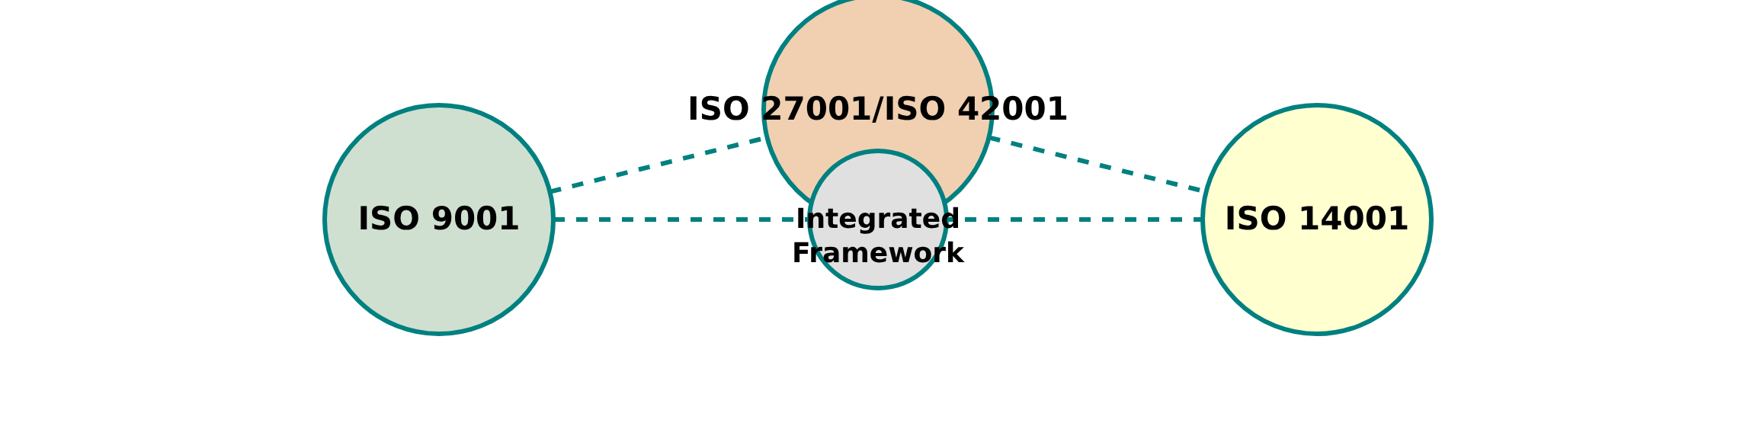




Integration with Other Standards
Creating a cohesive organizational framework by harmonizing management systems
Benefits of Integration
Integration Approaches
Eliminates duplicated efforts and resources
Common framework: Use one standard as the foundation
Creates consistent processes across the organization
Process alignment: Harmonize similar processes
Enhances overall efficiency and effectiveness
Document integration: Share policies and procedures
Provides a holistic approach to management
Joint audits: Conduct combined management reviews
ISO Lead Implementer Advanced Training | 21/23

Slide 22











Key Leadership Takeaways
Core principles for ISO Lead Implementers
Own the Audit Process
Improvement is a Journey
Communicate Strategically
Manage the entire audit program, not just participate in it.
Continual improvement requires constant attention and adaptation.
Use management reviews for strategic dialogue with senior management.
Think Beyond Certification
Never Stop Learning
Adapt to dynamic threats and technologies through lifelong learning.
Foster a secure and resilient organization, not just meet requirements.
ISO Lead Implementer Advanced Training | 22/23

Slide 23










Building Security Culture
Embedding continuous improvement for a secure, resilient enterprise
From Compliance to Culture
Continuous Learning
Transform from mere certification focus to embedding security and improvement as core organizational values
Foster environment where staying current with threats and technologies is valued and encouraged
Leadership by Example
Integration & Alignment
Demonstrate commitment to security culture through active participation and resource allocation
Connect security efforts with business objectives and other management systems for cohesive approach
Your Journey Continues
Building a secure, resilient enterprise is an ongoing journey. Your role as ISO Lead Implementer is crucial in navigating this path.
ISO Lead Implementer Advanced Training | 23/23

